Slide 1
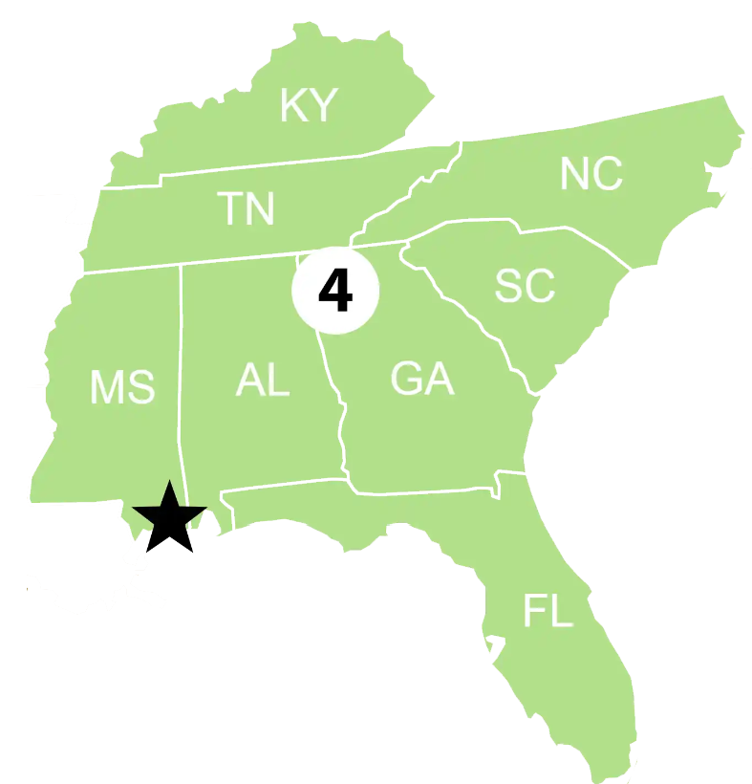

Sector Lower Mississippi River
Federalized cases:
UCGPN23032/ RP- Kirby Inland Marine LP/ Approximately 104bbl of Vacuum Tar Bottoms
Fund opened for $45,000.00 ($25963.01 for CG Direct Costs/ $336,227.26 for CG Interdict costs).
Total days on scene: 31 days
Estimated total miles of impacted shoreline: 10 miles
Notable cases or engagements:
4H / EPA Region 6 FOSC/ 5 sunken vessels total/ Multiple RP/ appx. 7,2000 gallons of oil/water mixture recovered.( USCG Supported EPA Region 6 FOSC)
ITV SONNY J – Allison and Sinking/ Estimated 21 Gallons of Oil, misc: From Engines​/A-Frames spudding down for salvage operations/ Used best management practices ​
3 biggest RRT-related concerns in your AOR:
1. Clear understanding of EPA boundaries along the MS River and CG Jurisdiction within the inland zone.
2. Vast Area of Responsibility and extensive response times due to distance.
3. Going between 2 RCPs from either EPA Region 4 or EPA Region 6, depending on river or river section.

